Slide 1
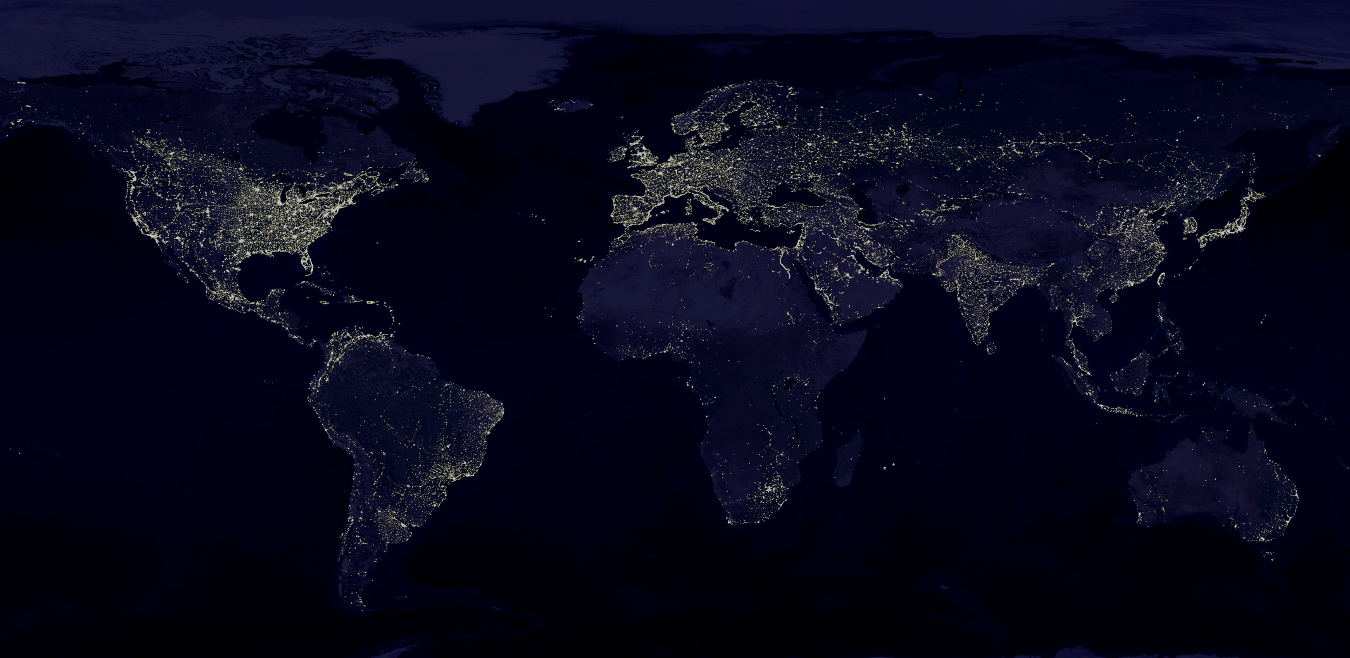



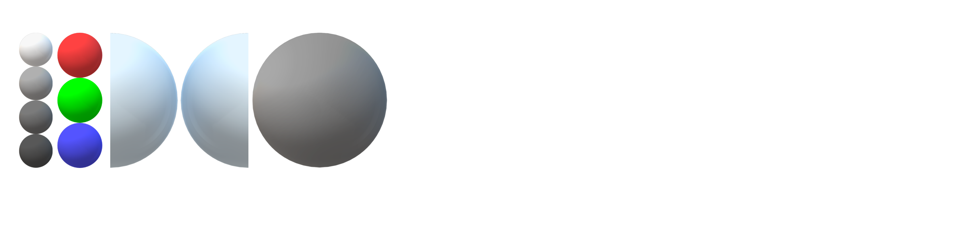







Slide 2
Great Barrier Reef Degradation, Sea Surface Temperatures, and Atmospheric CO2 Levels
Collectively Exhibit a Stochastic Process with Memory |
Allan R. B. Elnar ^{1,3}, Christianlly B. Cena ¹, Christopher C. Bernido^{1,2,∗} and M. Victoria Carpio-Bernido ^{1,2}
¹ Physics Department, University of San Carlos, Talamban, Cebu City 6000, Philippines
² Research Center for Theoretical Physics, Central Visayan Institute Foundation, Jagna, Bohol 6308, Philippines
³ Chemistry and Physics Department, Cebu Normal University, Cebu City 6000, Philippines
*corresponding author: cbernido.cvif@gmail.com
Received: May 2018
Published: June 2021 CLIMATE DYNAMICS (2022-2023) IF: 4.901 .

Slide 3
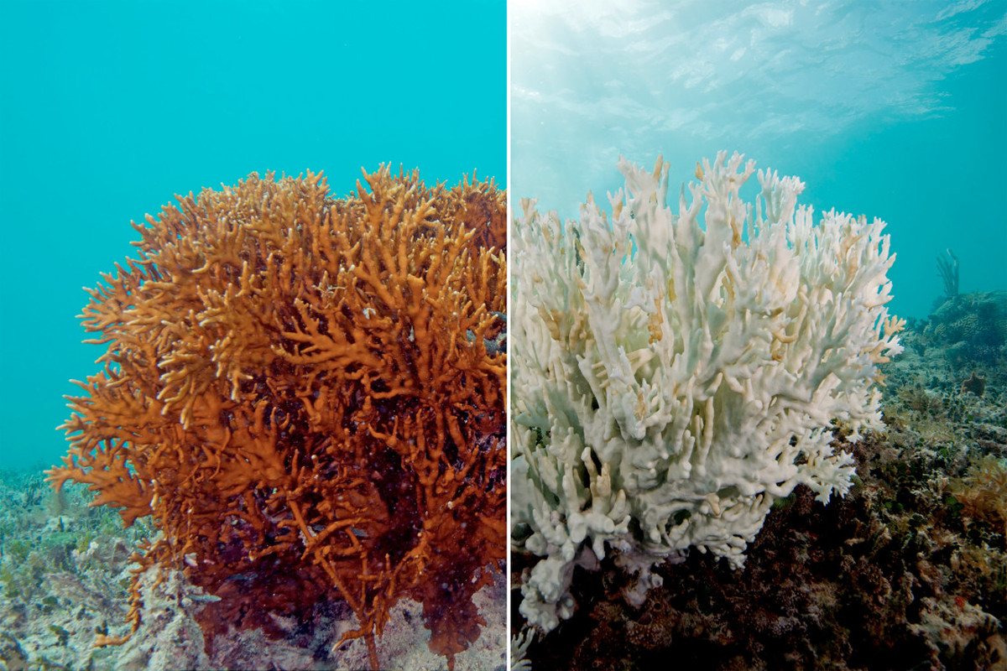
Coral Bleaching
https://www.vox.com/science-and-health/2017/4/18/15272634/catastrophic-coral-bleaching-great-barrier-reef-map
Notes:
In the past three decades, it has lost half its coral cover, pollution has caused deadly starfish outbreaks, and global warming has produced horrific coral bleaching. Coastal development also looms as a major threat.

Slide 4
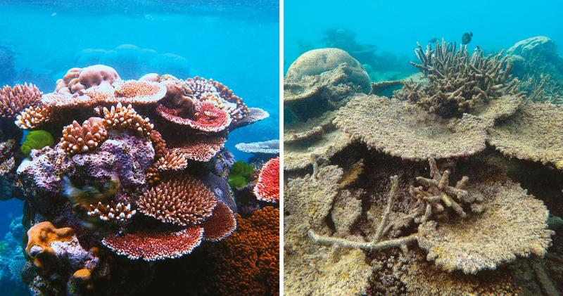
https://storymaps.arcgis.com/stories/6f219ead9e5442398da48f89c53a1b89
Notes:
https://storymaps.arcgis.com/stories/6f219ead9e5442398da48f89c53a1b89
In 2016, El Niño was responsible for a spike in ocean temperatures, which led to an unprecedented level of bleaching along the northern third of the reef. Scientists found as many as 95 percent of the corals surveyed in 2016 were severely bleached. Bleaching is not necessarily fatal for coral, as much as 67 percent of shallow-water corals died.

Slide 5
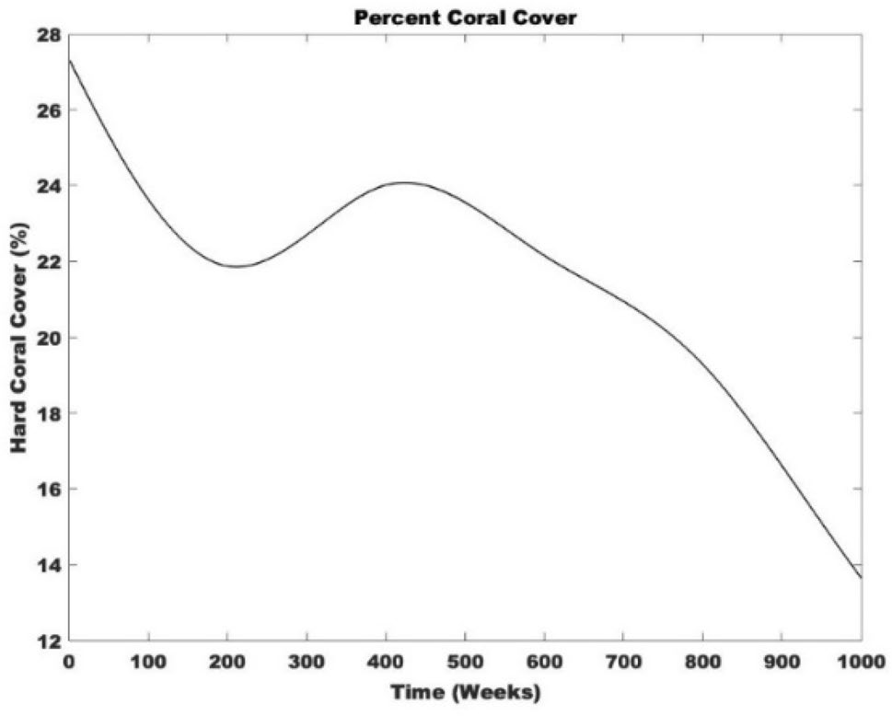
GBR Percent Coral Cover
Australian Institute of Marine Science (AIMS) accessible through the data portal data.gov.au (AIMS 2016)
July 1985 to June 2011

Slide 6
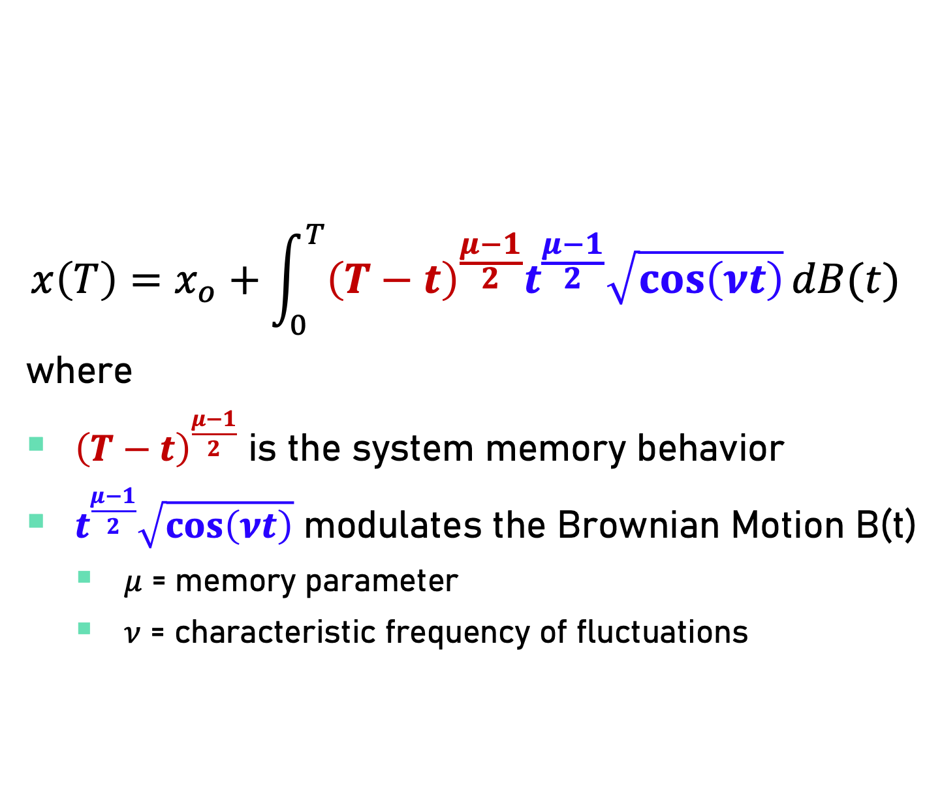
Stochastic Framework with Memory
$$x\left(T\right)=x_{o}+\int_{0}^{T}{{\left(T−t\right)}^{\frac{μ−1}{2}}t^{\frac{μ−1}{2}}\sqrt{\cos\left(νt\right)}}dB(t)$$
where
${\left(T−t\right)}^{\frac{μ−1}{2}}$ is the system memory behavior
$t^{\frac{μ−1}{2}}\sqrt{\cos\left(νt\right)}$ modulates the Brownian Motion B(t)
$μ$ = memory parameter
$ν$ = characteristic frequency of fluctuations

Slide 7
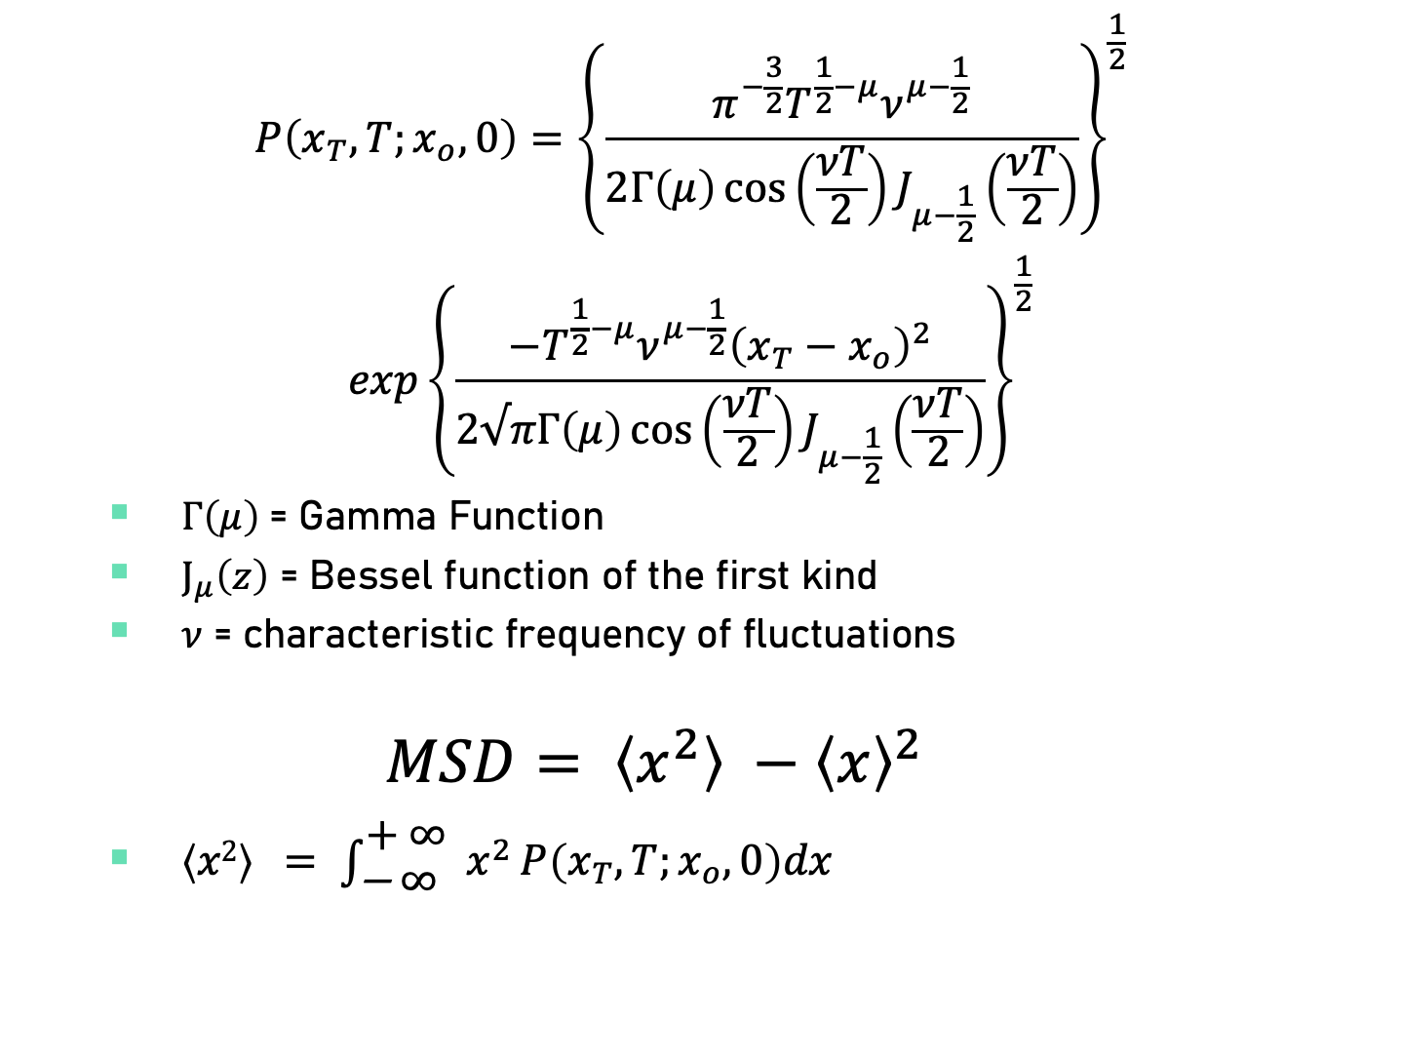
Probability Density Function (PDF)
$$P\left(x_{T}, T;x_{o}, 0\right)={\left\{\frac{π^{−\frac{3}{2}}T^{\frac{1}{2}−μ}ν^{μ−\frac{1}{2}}}{2Γ\left(μ\right)\cos\left(\frac{νT}{2}\right)J_{μ−\frac{1}{2}}\left(\frac{νT}{2}\right)}\right\}}^{\frac{1}{2}}$$
$$exp{\left\{\frac{−T^{\frac{1}{2}−μ}ν^{μ−\frac{1}{2}}{\left(x_{T}−x_{o}\right)}^{2}}{2√πΓ\left(μ\right)\cos\left(\frac{νT}{2}\right)J_{μ−\frac{1}{2}}\left(\frac{νT}{2}\right)}\right\}}^{\frac{1}{2}}$$
$Γ\left(μ\right)$= Gamma Function
$J_{μ}\left(z\right)$ = Bessel function of the first kind
$ν$ = characteristic frequency of fluctuations
$$MSD= \left\langle x^{2}\right\rangle −{\left\langle x\right\rangle }^{2}$$
${\left\langle x2\right\rangle }^{ }= \int_{\text{− }\text{∞ }}^{\text{+ }\text{∞ }}{x^{2}}P\left(x_{T}, T;x_{o}, 0\right)dx$

Slide 8
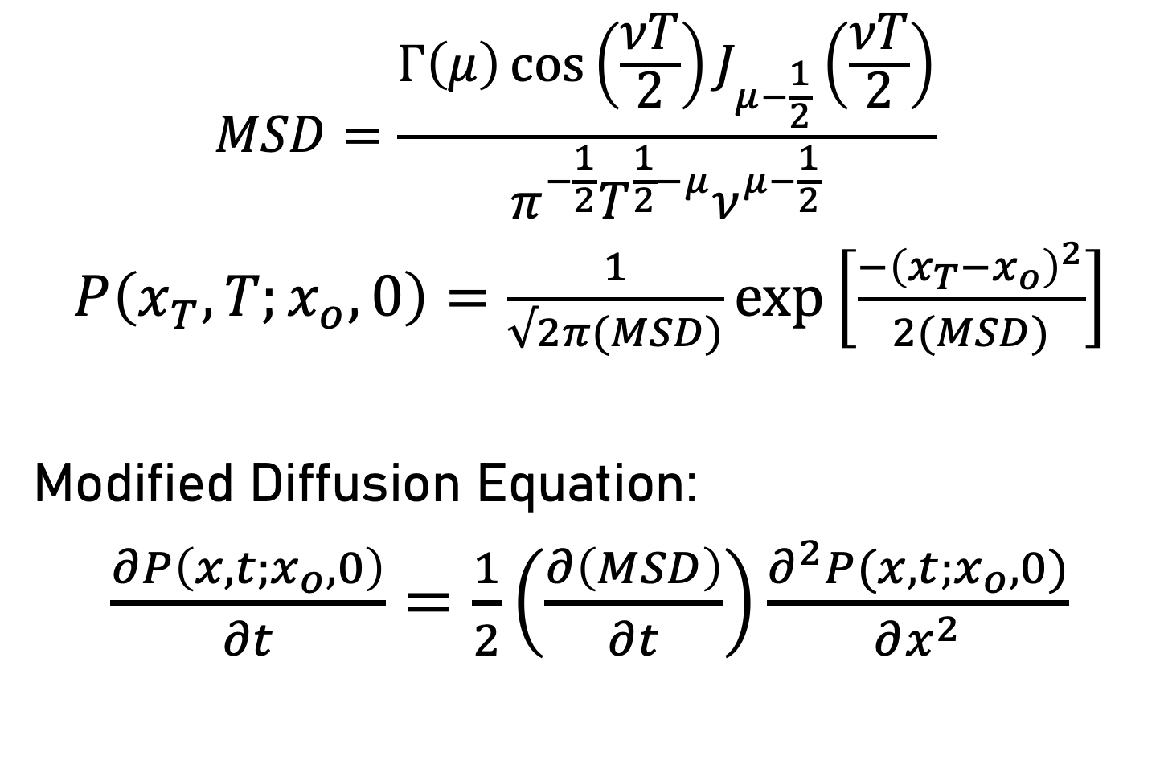
Mean Square Displacement (MSD)
$$MSD=\frac{Γ\left(μ\right)\cos\left(\frac{νT}{2}\right)J_{μ−\frac{1}{2}}\left(\frac{νT}{2}\right)}{π^{−\frac{1}{2}}T^{\frac{1}{2}−μ}ν^{μ−\frac{1}{2}}}$$
$P\left(x_{T}, T;x_{o}, 0\right)=\frac{1}{√2π(MSD)}\exp\left[\frac{−{\left(x_{T}−x_{o}\right)}^{2}}{2(MSD)}\right]$
Modified Diffusion Equation:
$\frac{∂P\left(x, t;x_{o}, 0\right)}{∂t}=\frac{1}{2}\left(\frac{∂\left(MSD\right)}{∂t}\right)\frac{∂^{2}P(x,t;x_{o}, 0)}{∂x^{2}}$

Slide 9
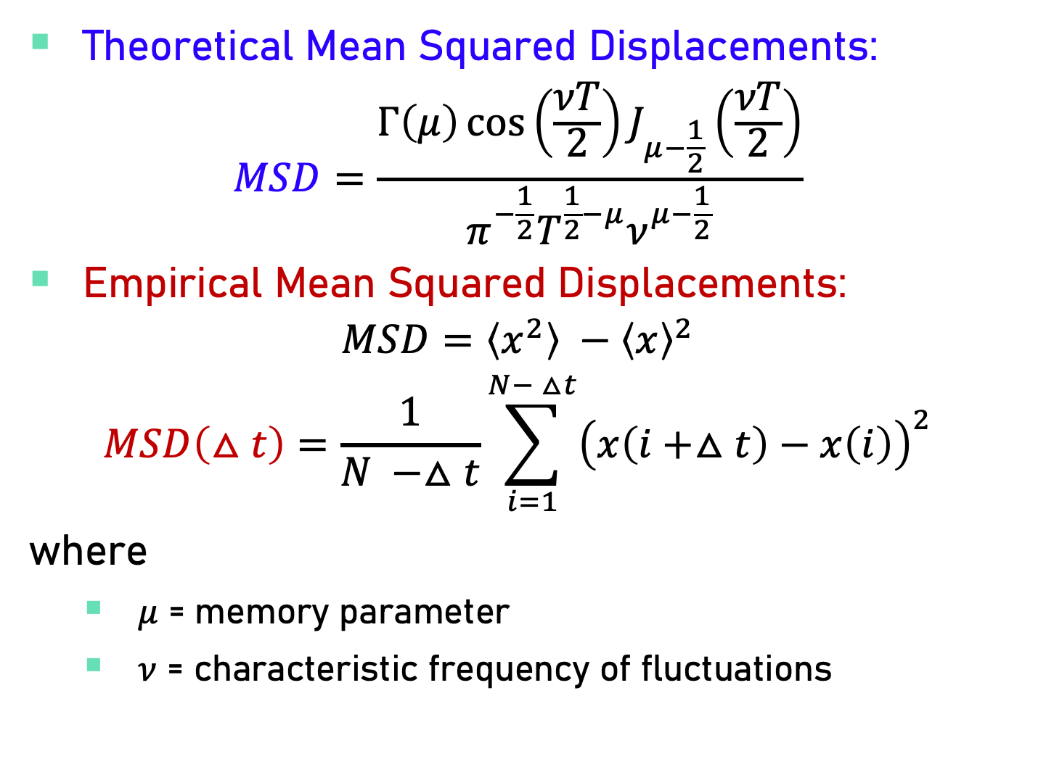
Theoretical vs Empirical MSDs
Theoretical Mean Squared Displacements:
$$MSD=\frac{Γ\left(μ\right)\cos\left(\frac{νT}{2}\right)J_{μ−\frac{1}{2}}\left(\frac{νT}{2}\right)}{π^{−\frac{1}{2}}T^{\frac{1}{2}−μ}ν^{μ−\frac{1}{2}}}$$
Empirical Mean Squared Displacements:
$$MSD=\left\langle x^{2}\right\rangle −{\left\langle x\right\rangle }^{2}$$
$$MSD\left(△t\right)=\frac{1}{N −△t}\sum_{i=1}^{N− △t}{{\left(x\left(i+△t\right)−x\left(i\right)\right)}^{2}}$$
where
$μ$ = memory parameter
$ν$ = characteristic frequency of fluctuations

Slide 10
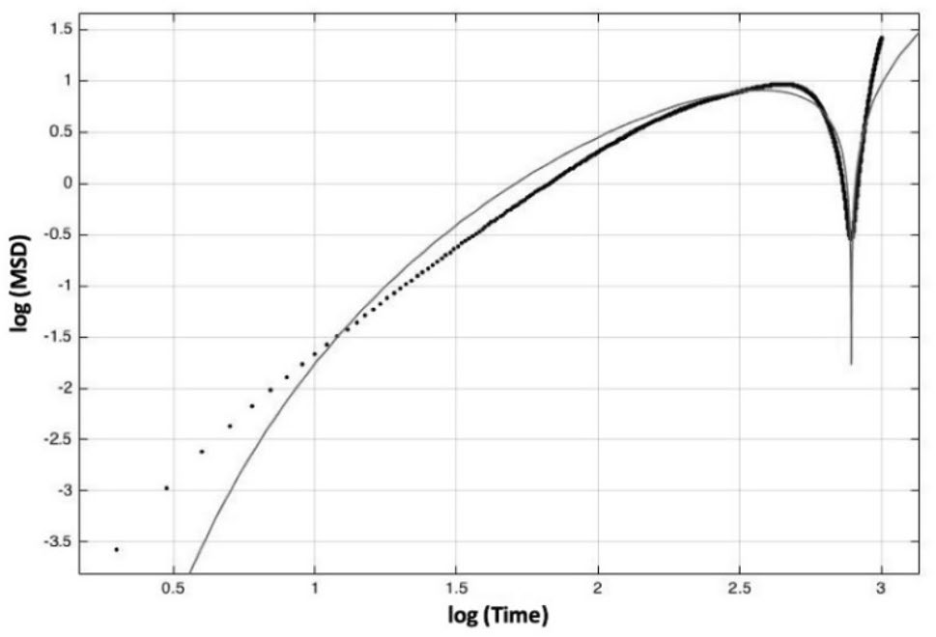
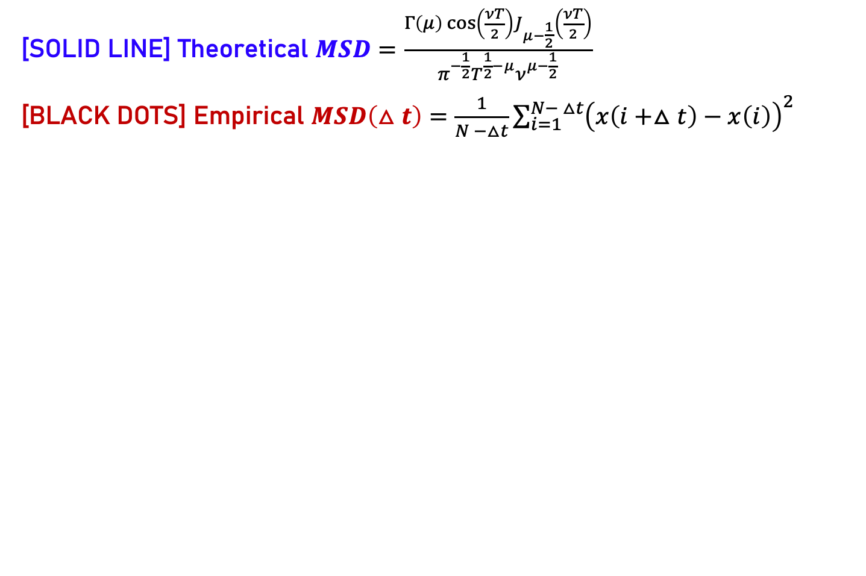
GBR: Theo vs Empirical MSDs
[SOLID LINE] Theoretical $MSD=\frac{Γ\left(μ\right)\cos\left(\frac{νT}{2}\right)J_{μ−\frac{1}{2}}\left(\frac{νT}{2}\right)}{π^{−\frac{1}{2}}T^{\frac{1}{2}−μ}ν^{μ−\frac{1}{2}}}$
[BLACK DOTS] Empirical $MSD\left(△t\right)=\frac{1}{N −△t}\sum_{i=1}^{N− △t}{{\left(x\left(i+△t\right)−x\left(i\right)\right)}^{2}}$

Slide 11
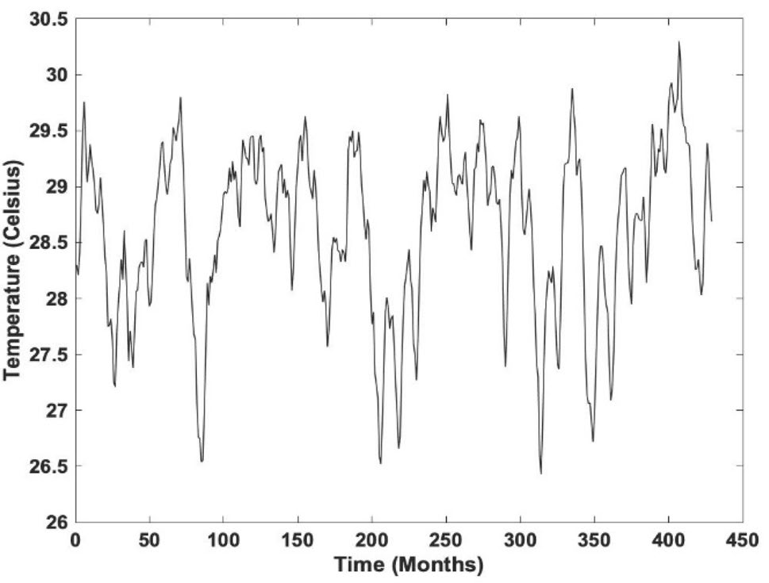
Sea Surface Temperature data
NOAA for monthly data from January 1982 to October 2017
(https://www.ncdc.noaa.gov/teleconnections/enso/indicators/sst.php)

Slide 12
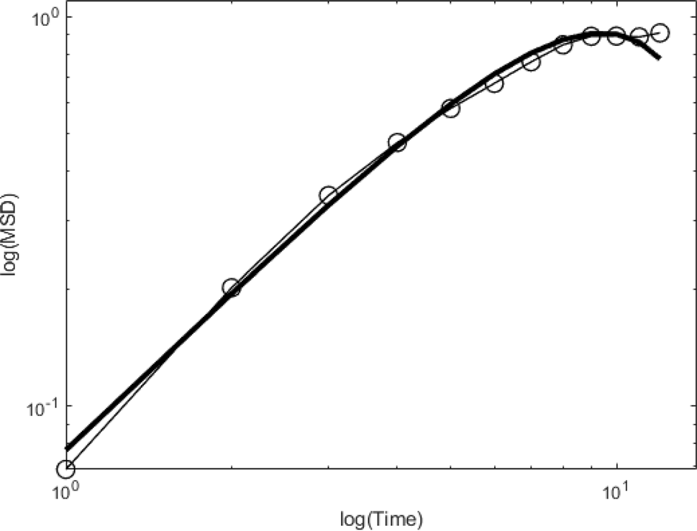
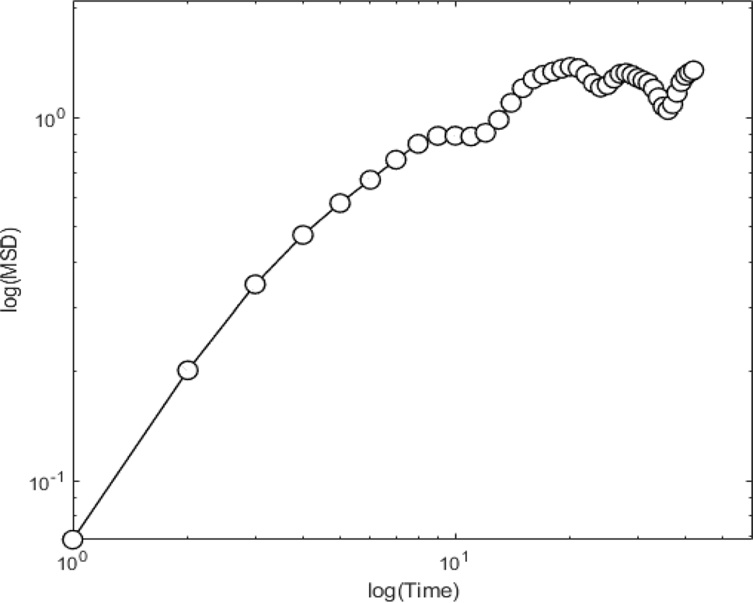
SST: Theo vs Empirical MSDs
[SOLID LINE] Theoretical $MSD=\frac{Γ\left(μ\right)\cos\left(\frac{νT}{2}\right)J_{μ−\frac{1}{2}}\left(\frac{νT}{2}\right)}{π^{−\frac{1}{2}}T^{\frac{1}{2}−μ}ν^{μ−\frac{1}{2}}}$
[BLACK DOTS] Empirical $MSD\left(△t\right)=\frac{1}{N −△t}\sum_{i=1}^{N− △t}{{\left(x\left(i+△t\right)−x\left(i\right)\right)}^{2}}$
Multiples of 12 months log(Time)

Slide 13
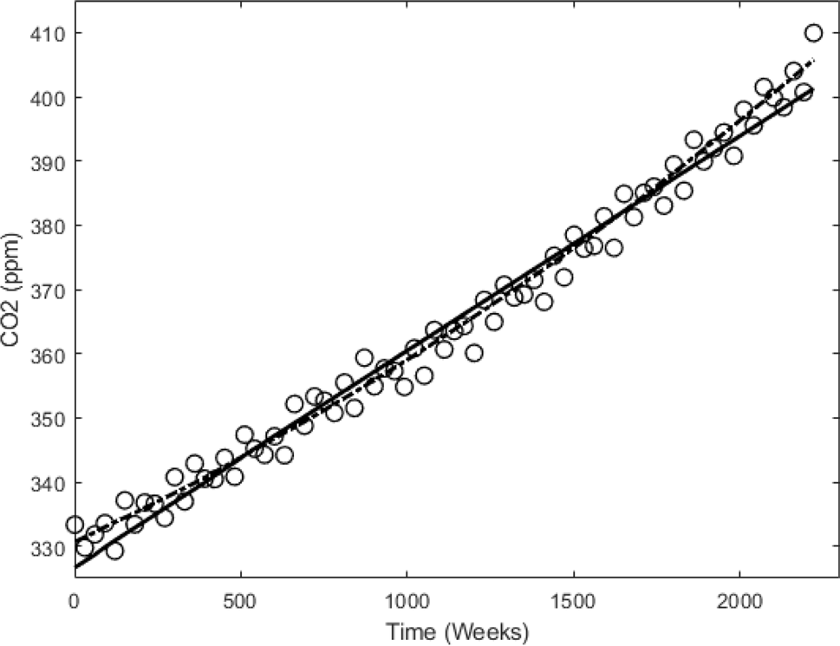
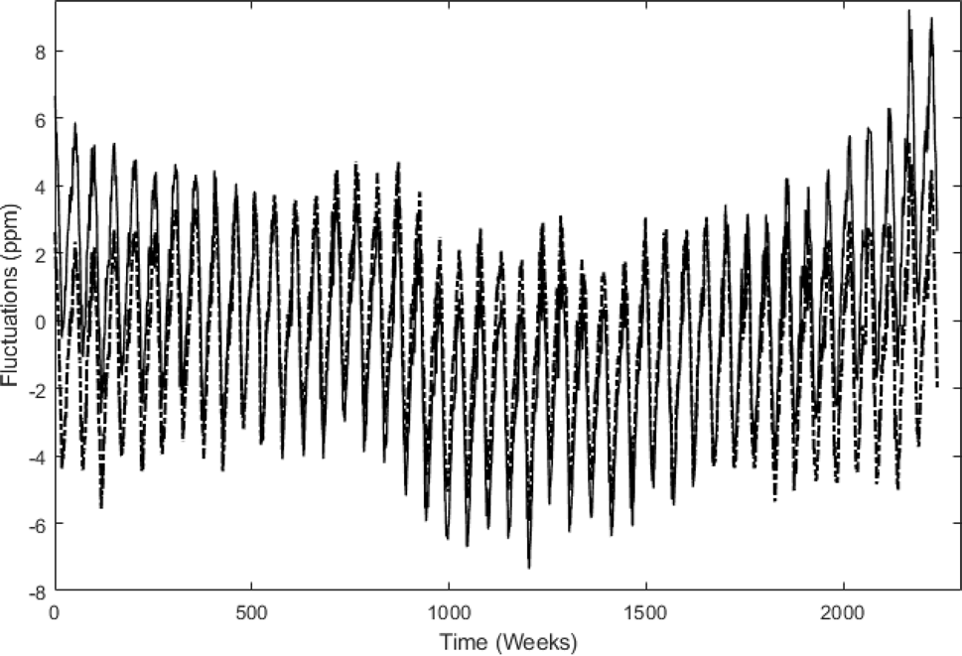
CO₂ Levels
Keeling curve for atmospheric CO2 levels measured by the Mauna Loa Observatory of the National Oceanic Atmospheric Administration (NOAA, www. esrl.noaa.gov) in the island of Hawaii.

Slide 14
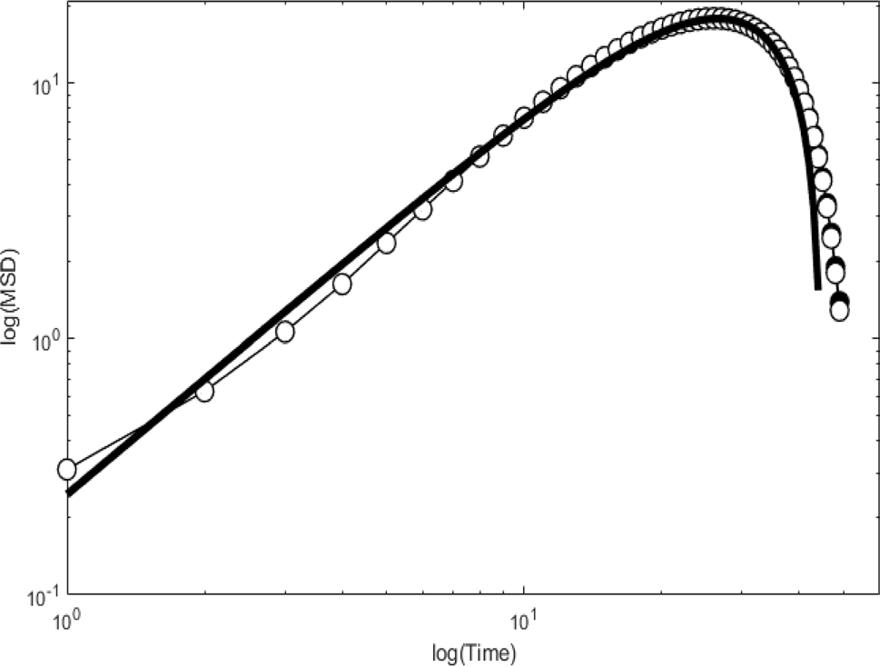
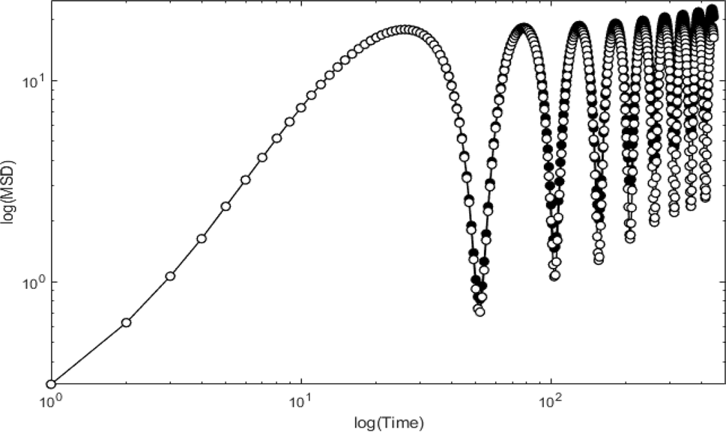
CO₂: Theo vs Empirical MSDs
[SOLID LINE] Theoretical $MSD=\frac{Γ\left(μ\right)\cos\left(\frac{νT}{2}\right)J_{μ−\frac{1}{2}}\left(\frac{νT}{2}\right)}{π^{−\frac{1}{2}}T^{\frac{1}{2}−μ}ν^{μ−\frac{1}{2}}}$
[BLACK DOTS] Empirical $MSD\left(△t\right)=\frac{1}{N −△t}\sum_{i=1}^{N− △t}{{\left(x\left(i+△t\right)−x\left(i\right)\right)}^{2}}$
Multiples of 12 months log(Time)

Slide 15
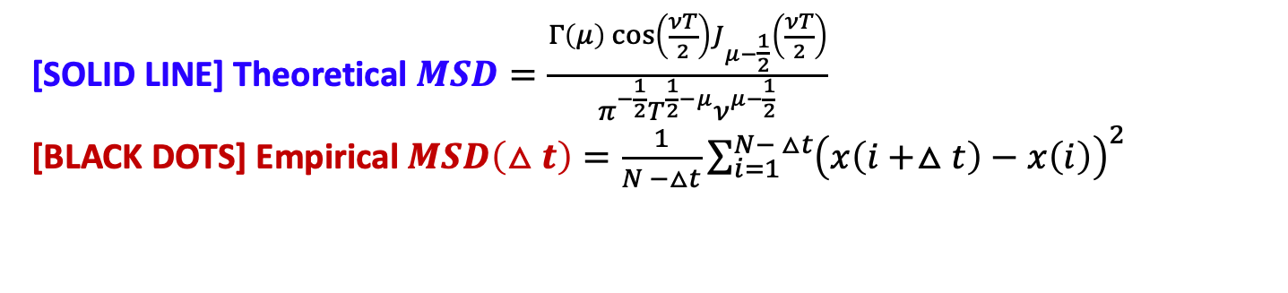
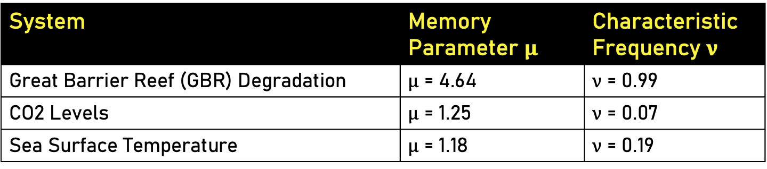
Summary
System | Memory Parameter $μ$ | Characteristic Frequency $ν$
Great Barrier Reef (GBR) Degradation | $μ$ = 4.64 | $ν$ = 0.99
CO2 Levels | $μ$ = 1.25 | $ν$ = 0.07
Sea Surface Temperature | $μ$ = 1.18 | $ν$ = 0.19
[SOLID LINE] Theoretical $MSD=\frac{Γ\left(μ\right)\cos\left(\frac{νT}{2}\right)J_{μ−\frac{1}{2}}\left(\frac{νT}{2}\right)}{π^{−\frac{1}{2}}T^{\frac{1}{2}−μ}ν^{μ−\frac{1}{2}}}$
[BLACK DOTS] Empirical $MSD\left(△t\right)=\frac{1}{N −△t}\sum_{i=1}^{N− △t}{{\left(x\left(i+△t\right)−x\left(i\right)\right)}^{2}}$
GBR
SST
CO₂
Notes:
A good match between the empirical and theoretical MSD’s was attained for each phenomenon indicating that all three systems are described by the same class of non-Markovian stochastic processes.
A comparative insight into the complex dynamics of the GBR degradation, SST, and atmospheric CO2 levels can be seen by summarizing values of the memory parameter μ and characteristic frequency as shown in Table 1.

Slide 16
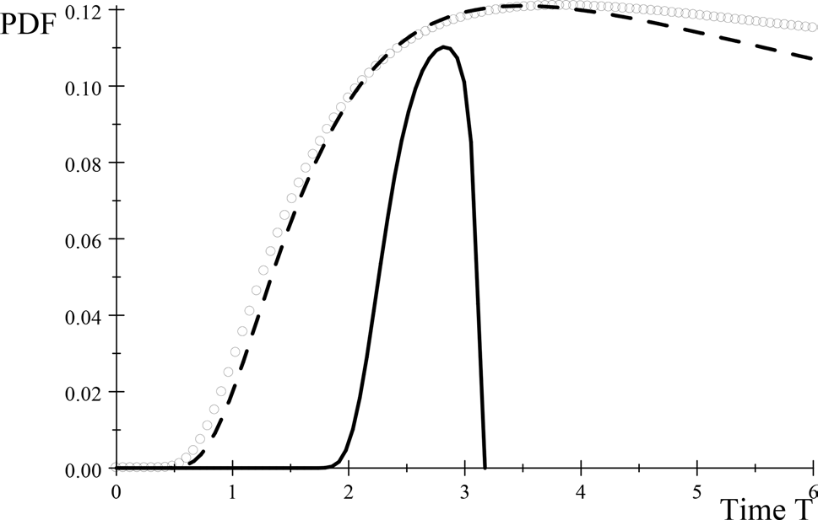
Summary
System | Memory Parameter $μ$ | Characteristic Frequency $ν$
Great Barrier Reef (GBR) Degradation | $μ$ = 4.64 | $ν$ = 0.99
CO2 Levels | $μ$ = 1.25 | $ν$ = 0.07
Sea Surface Temperature | $μ$ = 1.18 | $ν$ = 0.19
Probability density function (PDF) versus time for the GBR (black solid line, sea surface temperatures (circles), and CO2
levels (dashed line)
Notes:
Specifically, for atmospheric CO2 and SST, we have superdiffusive values of the exponent where, 1 < 𝛼 < 2 , while
for the GBR degradation the value is, 2 < 𝛼 , which falls in the hyperballistic domain.

Slide 17
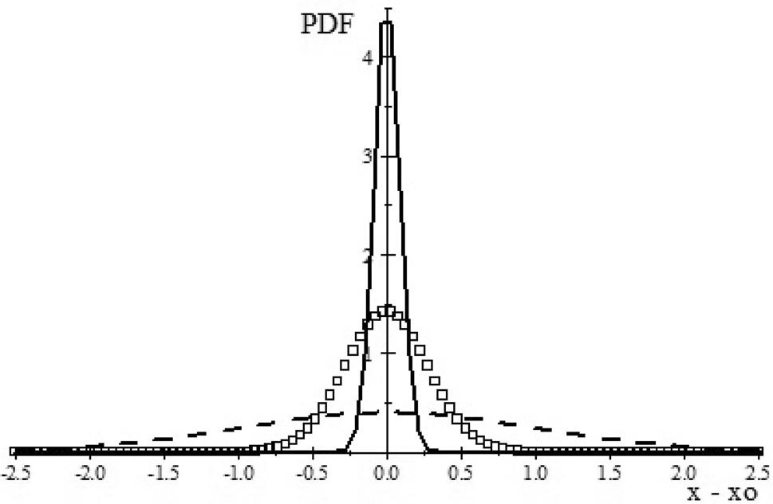
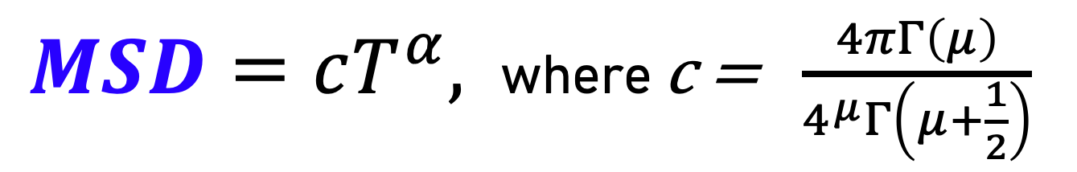
Summary
$MSD=cT^{α},$where c = $\frac{4πΓ\left(μ\right)}{4^{μ}Γ\left(μ+\frac{1}{2}\right)}$
Subdiffusion (dashed line, 𝛼 = 0.4 ); Superdiffusion (open boxes, 𝛼 = 1.36 ); Hyperballistic diffusion (solid line, 𝛼 = 2.3 ). All plots are at T = 0.2
Notes:
Specifically, for atmospheric CO2 and SST, we have superdiffusive values of the exponent where, 1 < 𝛼 < 2 , while
for the GBR degradation the value is, 2 < 𝛼 , which falls in the hyperballistic domain.

Slide 18
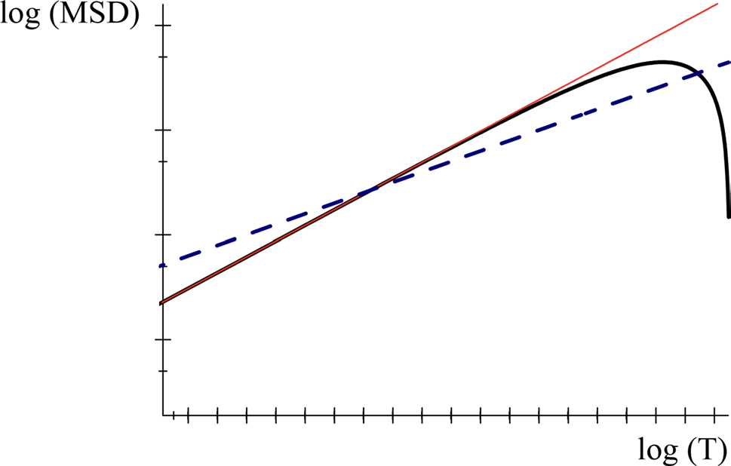
Conclusions
All three systems are described by the same class of non-Markovian stochastic processes
MSD for different memory behavior. Dashed line: Brownian motion (no memory); red straight line: anomalous diffusion; curved black line: stochastic process with memory describing the GBR, CO2 levels, and sea surface temperatures

Slide 19
Conclusions
The lesser values of the anomalous exponent for atmospheric CO₂ as compared to a large value of for the GBR, attributed to the fact that atmospheric CO₂ and the ocean are much larger systems than the GBR and, therefore, more capable of absorbing ecological disturbances.
Small fluctuations in atmospheric CO₂ and SST temperatures could have a dramatic effect on the GBR.
Subdiffusion (dashed line, 𝛼 = 0.4 ); SST, CO2: Superdiffusion (open boxes, 𝛼 = 1.36 ); GBR: Hyperballistic diffusion (solid line, 𝛼 = 2.3 ). All plots are at T = 0.2

Slide 20
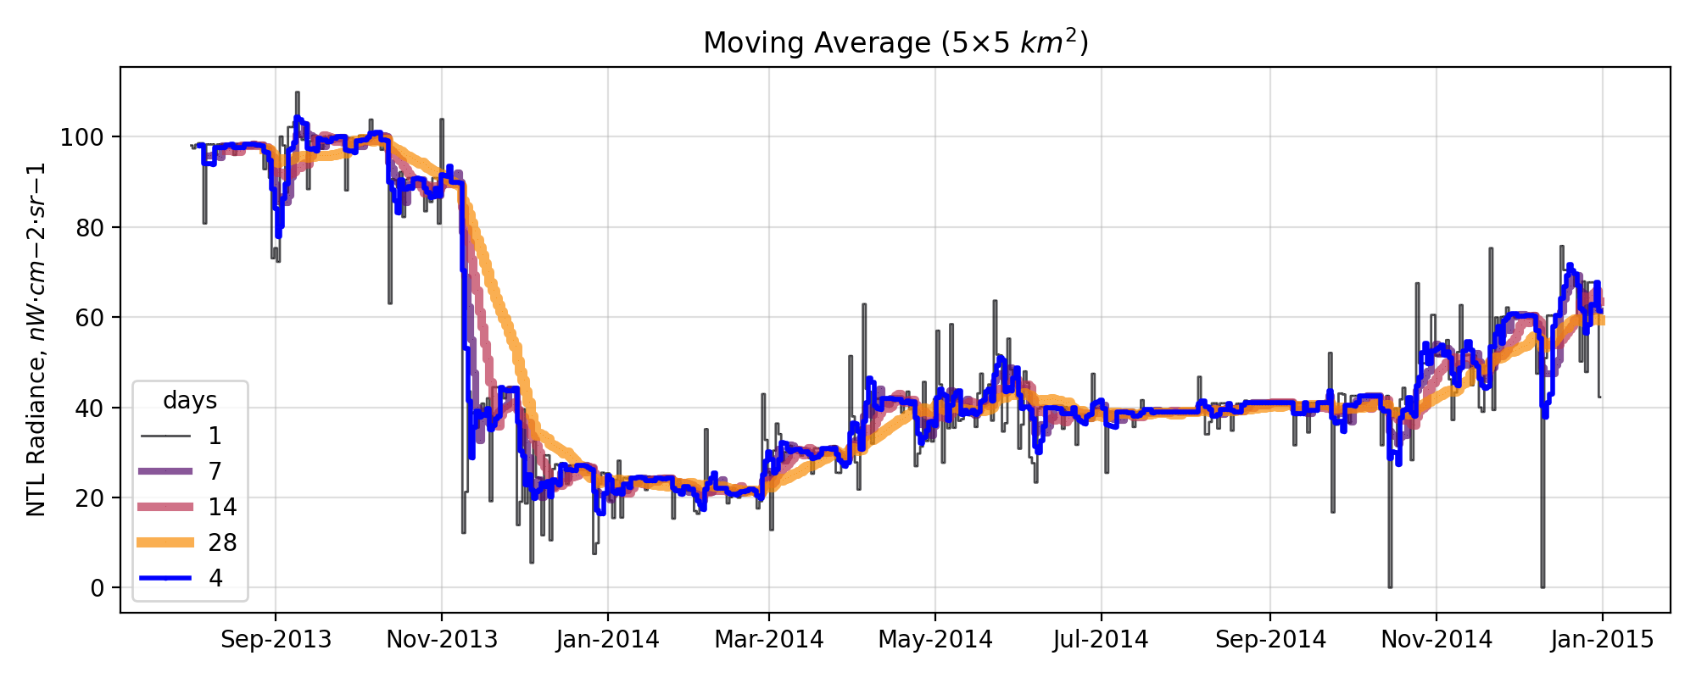
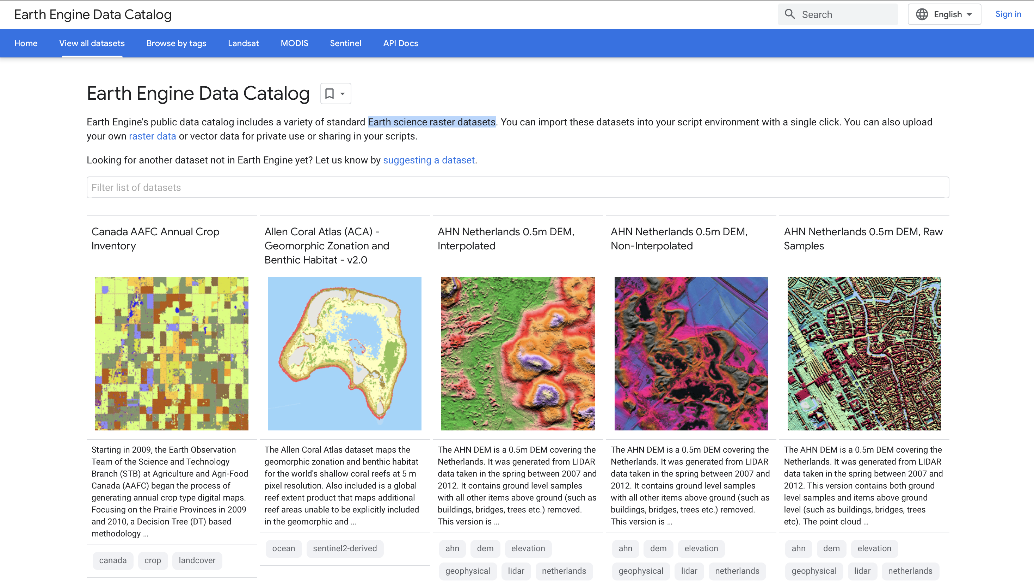
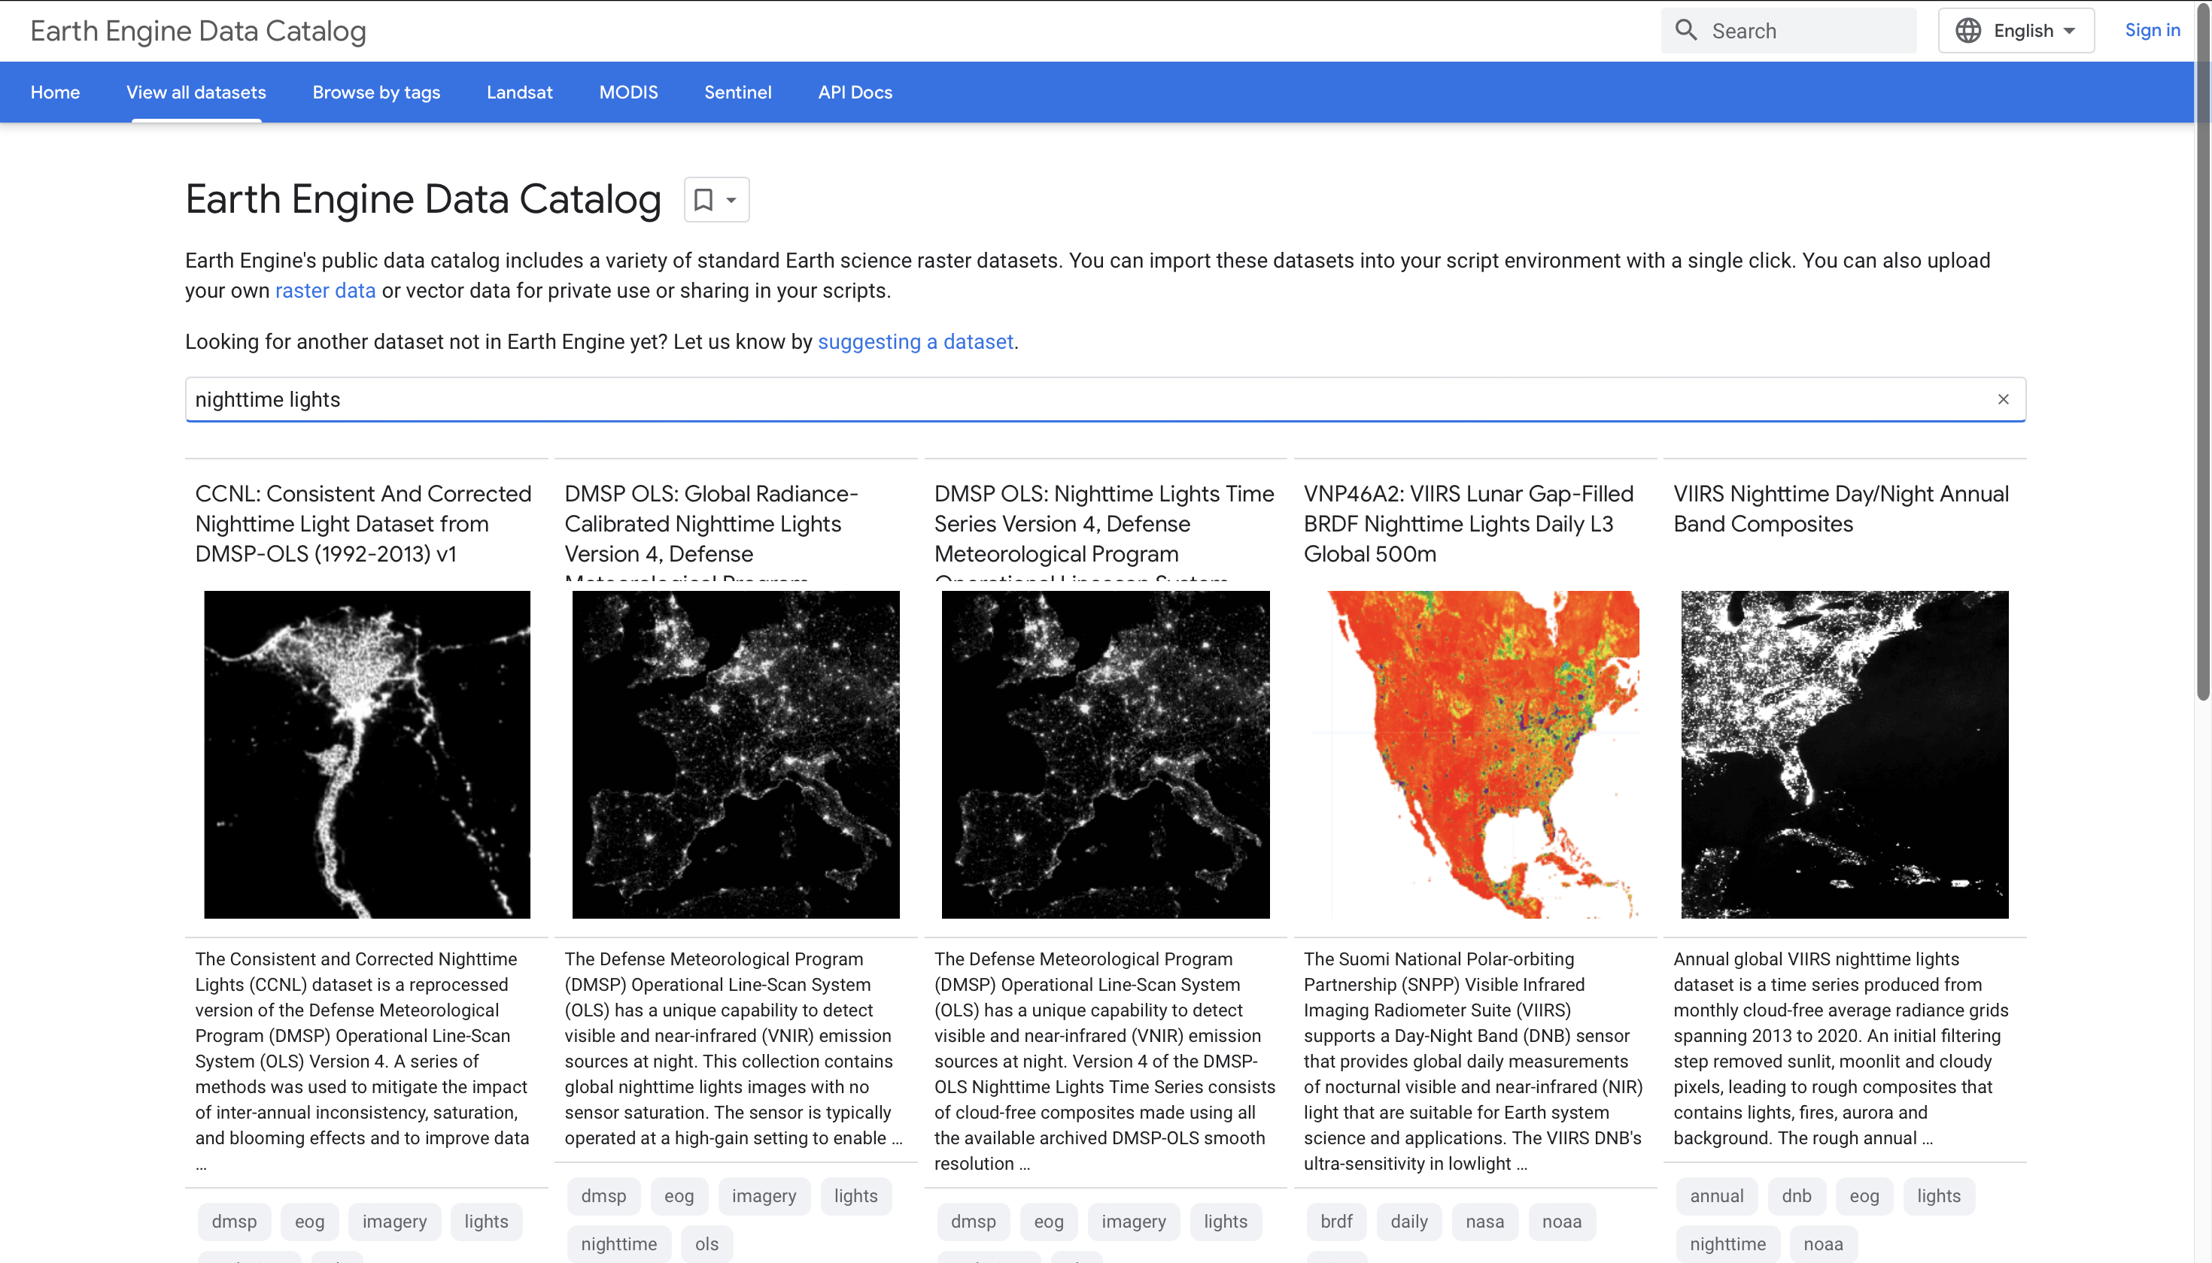
Take-aways
Apply non-Markovian stochastic processes analytical framework on NTL and other data.

